Slide 1

Welcome

Slide 2
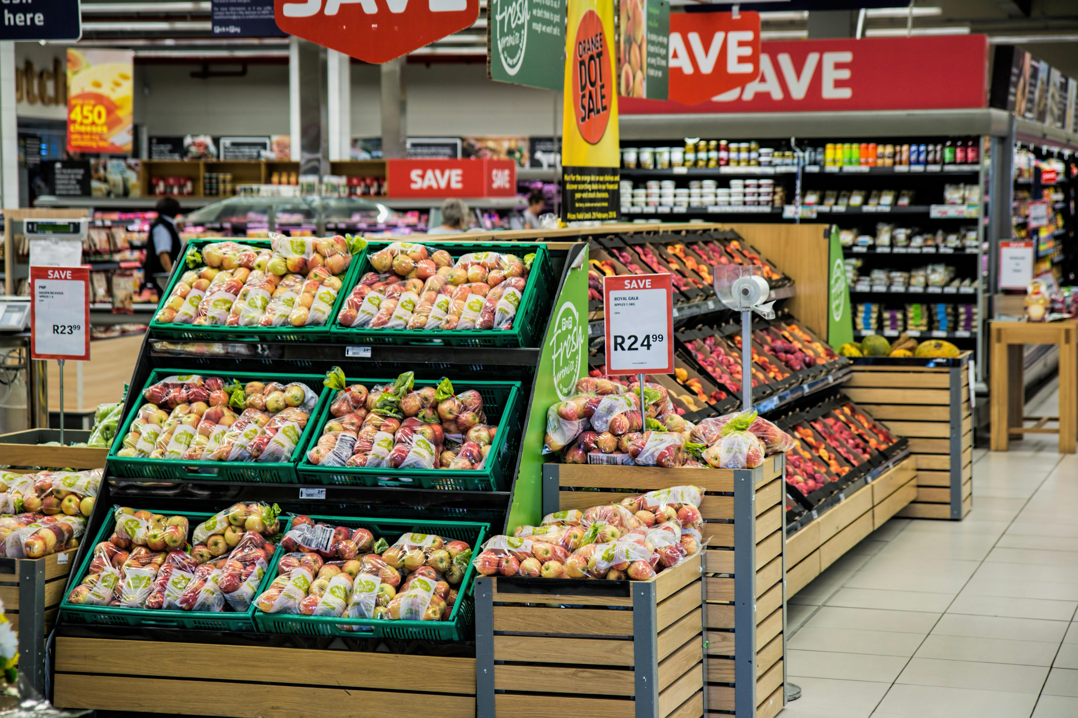
Sales Analysis
Name : Deepti Horakeri
Batch : B4 Online July
Date : 02/20/2025

Slide 3
Dataset Overview:
Order_id: Unique identifier for an order.
Order_date: Date when the order was placed.
Ship_date: Date when the order was shipped.
Ship_mode: The type of shipping method used (e.g., Standard, Express).
Gender: Gender of the customer.
Ip_address: Customer's IP address at the time of the order.
Customer_id: Unique identifier for the customer.
Segment: Customer segment (e.g., Consumer, Corporate).
City: City where the order was placed.

Slide 4
State: State where the order was placed.
Country: Country where the order was placed.
Category: Main category of the product (e.g., Electronics, Furniture).
Sub Category: Sub-category of the product (e.g., Phones, Chairs).
Product Name: Name of the purchased product.
Quantity: Number of units ordered.
Discount: Discount applied to the order.
Profit: Profit earned from the order.
Shipping Cost: Cost incurred for shipping the order.

Slide 5
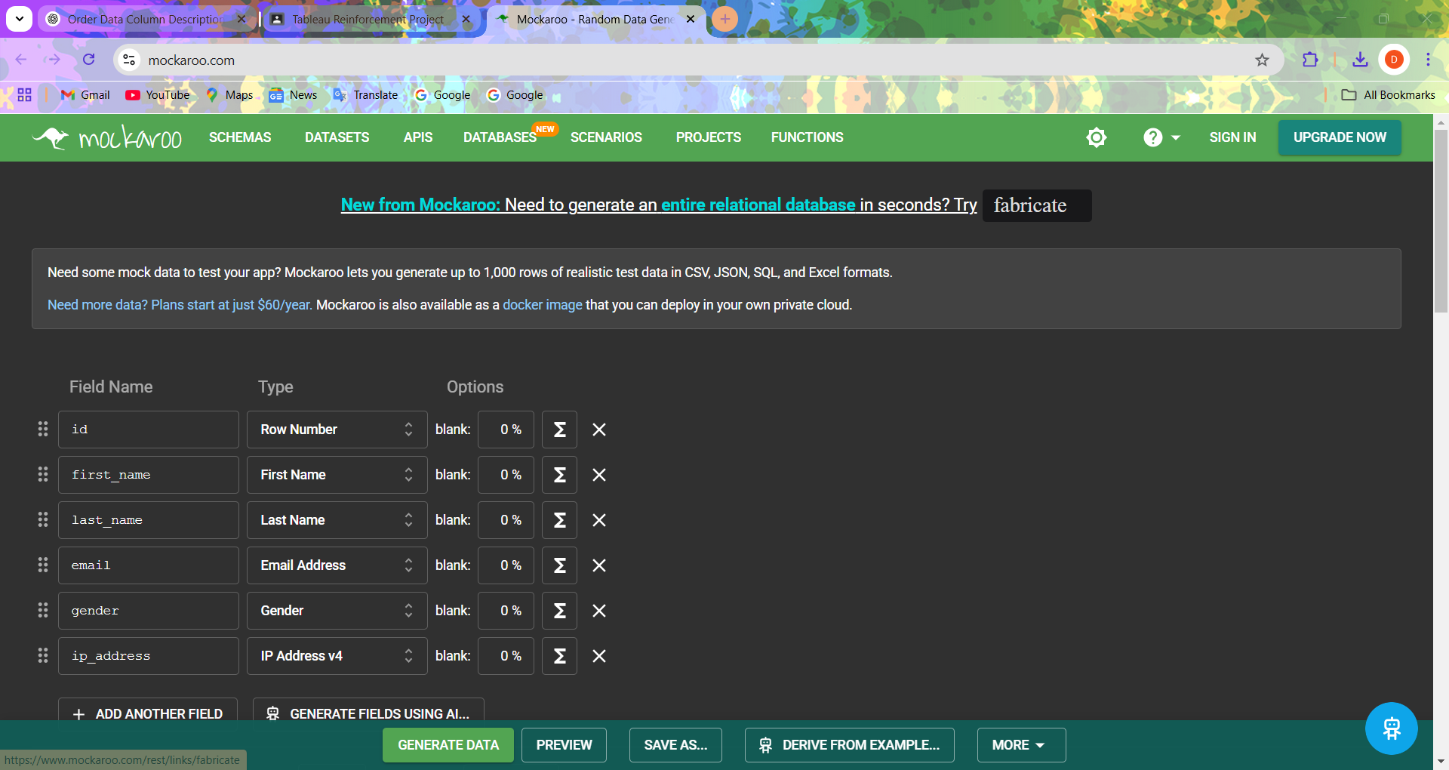
Dataset Created:

Slide 6
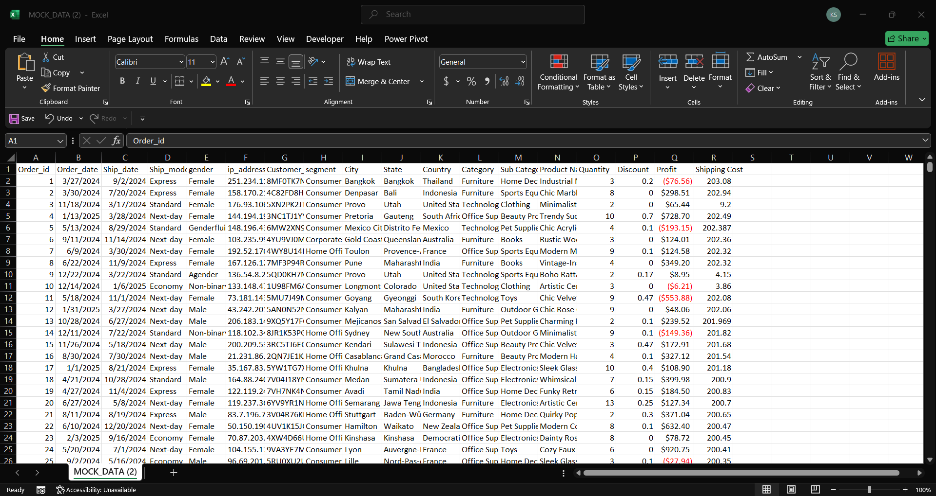
Excel :

Slide 7
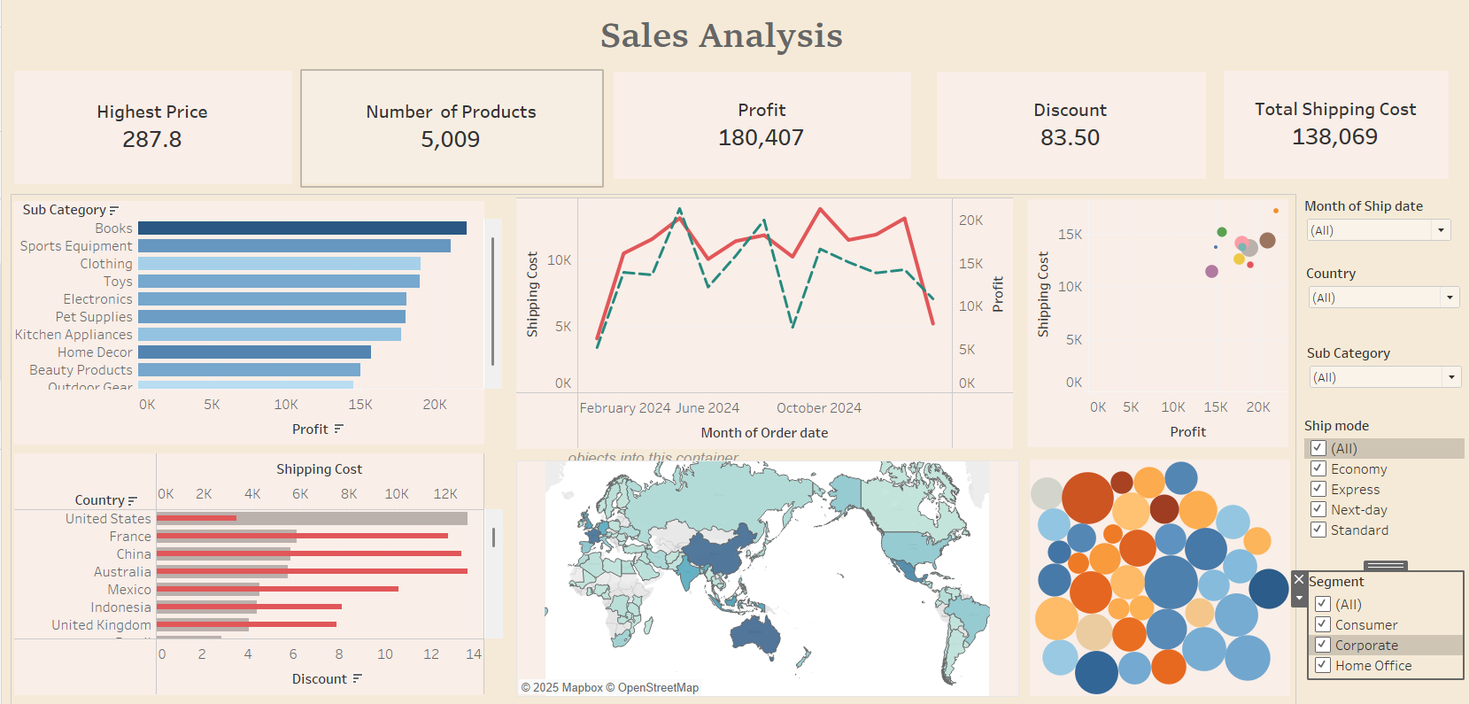

Slide 8
Key Insights:
Office Supplies is having highest shipping cost most of the time after April 2024.
Australia is having the highest shipping cost of $12,942.
Books is having the highest profits among all categories.
Books is having the highest shipping cost as well as profit.
Highest shipping cost is for Australia but with a less amount of discount whereas with highest discount United States is having low shipping cost .
With ship mode Standard for clothing category with less discount gained high profit.

Slide 9

Thank You

